Slide 1

DIET4Elders: a Service Oriented Architecture for the Prevention and Self-Management of Malnutrition
FACULTY OF AUTOMATION AND COMPUTER SCIENCE
COMPUTER SCIENCE DEPARTMENT
Student
Akos Tiberiu Boros
Tudor Cristian Prigoana
Supervisor
Dr. Eng. Viorica Rozina CHIFU
Dr. Eng. Cristina Bianca POP

Slide 2
Contents
Introduction
Motivation
Related Work
Proposed Solution
Implementation Status
Current Results
Bibliography

Slide 3
Introduction
What is DIET4Elders?
It is an international project that was started on July 1st, 2013 by the AAL Join Programme that comprises entities from different sectors like universities, telecare companies, food providers companies and ICT SMEs.
Partners:
ISOIN – coordinator (Spain)
Tunstall Healthcare Ltd. – Business (UK)
COESCO DEZA S.L. - end-users (Spain)
Kings College London - R&D (UK)
Technical University of Cluj-Napoca - R&D (Romania)

Slide 4
Introduction
DIET4Elders Global Objectives:
assist older adults and their informal carers during daily self-feeding activities and is aimed at detecting and preventing the instauration of malnutrition
help the nutritionists to establish the degree in which the older adults follow their prescribed diet and to dynamically adjust it
enable the dynamic selection, based on the prescribed diet, of suitable food service provider and potentially enable automated shopping

Slide 5
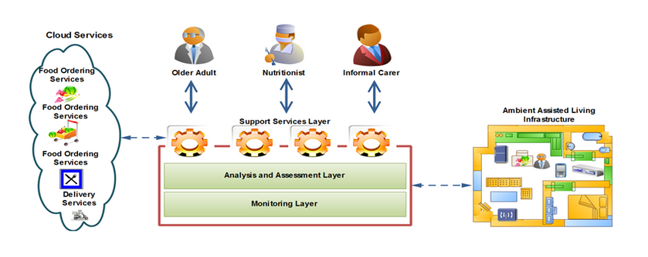
Introduction

Slide 6
Introduction
DIET4Elders Objectives for Current Application:
Generate the best combination of daily menus that are provided by local food vendors that is best suitable for the user’s health profile, i.e. based on the
User’s allergies
Medical prescription
Preferences
Daily recommended nutrient values
Cost and delivery time

Slide 7
Motivation
Why is this project of great importance?
In Europe over 15% of the elderly population is affected by malnutrition
Recent studies have shown that the ratio of retirees to workers in Europe will double to 0.54 by 2050
The growth of senior population will result a need of medical care services that the current medical care systems cannot withstand
Reduce costs by using the proposed automated carer for nutrition
Improve the overall medical system care experience

Slide 8
Related Work
Optimization Algorithm related to Honey Bee Mating Optimization (HBMO) used in this application
Particle swarm optimization
Ant colony swarm-based optimization
Other bio-inspired optimization algorithm that are in the same field

Slide 9
Proposed Solution
Problem definition
“Given a repository of food packages (i.e. set of food items corresponding to breakfast, lunch, dinner or snack) provided by several food providers, find the optimal combination of food packages for each of the meals of a day such that they meet an older adult’s profile (containing information about its preferred food and allergies), price and delivery time constraints, and recommended diet”.
In this case, a solution of the optimization problem is formally represented as follows:
where fP_{b}, fP_{s1}, fP_{l}, fP_{s2} and fP_{d} are the food packages selected for breakfast, the first snack, lunch, the second snack, and dinner respectively

Slide 10
Proposed Solution
How is a menu evaluated? a.k.a Fitness Function
A solution of the optimization problem is evaluated using the following fitness function:
where fitness_{nutrient} evaluates the quality of a solution from the nutrients point of view, while fitness_{diet} evaluates the quality of a solution from the recommended diet point of view.

Slide 11
Proposed Solution
The formula for evaluating the quality of a solution from the nutrients point of view is defined as follows
where m(n) is the quantity of nutrient n, ideal(n) is the ideal quantity of nutrient n as recommended by nutritionists, E is the margin of error evaluated between the quantity of nutrient n and the ideal quantity of nutrient n, w_{n} is a weight associated to a nutrient n, and N is the set of nutrients.
The margin of error is computed as

Slide 12
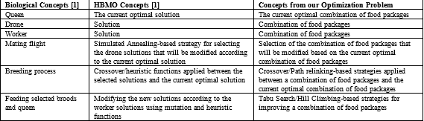
Proposed Solution
The Core Component
The core component of our model is the Honey Bees Mating Optimization-based component which is defined by mapping the concepts from the state of the art Honey Bees Mating Optimization algorithm to the concepts associated to the problem of generating the optimal combination of food packages for the meals of the day as follows.

Slide 13
Proposed Solution
The Hybridization Component
The hybridization components that will be injected in the model’s core component are classified in two categories according to the point in which they can be injected.
Genotype Combining:
Crossover-based Hybridization Component
Path Relinking-based Hybridization Component
Brood Mutation:
Tabu Search component
Hill Climbing component
Simulated Annealing

Slide 14
Proposed Solution
DIET4Elders Model
All ingredients or basic food components are taken from the USDA National Nutrient Database from this site http://ndb.nal.usda.gov/
For reasoning purposes OWL Ontologies are used
Contains daily menu packages provided by local food vendors with additional information
User health profile is retained for obtaining personalized results

Slide 15
Implementation Status
At this time (presentation time) we are currently in week 26th of our work timeline where we are working on stabilizing the algorithm and the flow of the application, and on improving results by optimizing performance
Done:
DIET4Elders database and ontology modeling with real data
Business logic layer with services that query the ontology according to demand
Hybrid optimization algorithm implemented
To do:
Refine and tune algorithm
Graphical User Interface

Slide 16
Current Results
Heuristics Applied I | Heuristics Applied II | Population Size | Best Fitness Solution (0 to 1, where 1 is optimal) | Worst Fitness Solution | Number Of Iterations Average
Hill Climbing | CrossOver | 500 | 0.9124 | 0.8215 | 25
Climbing | Path-Relinking | 500 | 0.9015 | 0.8368 | 25
Simulated-Annealing | CrossOver | 500 | 0.9079 | 0.8568 | 26
Simulated-Annealing | Path-Relinking | 500 | 0.9089 | 0.8458 | 27

Slide 17
Bibliography
[1] Honey-Bees Mating Optimization (HBMO) Algorithm: A New Heuristic Approach for Water Resources Optimization -- OMID BOZORG HADDAD1∗, ABBAS AFSHAR1, and MIGUEL A. MARI˜NO2
[2] Artificial Intelligence: A Modern Approach – Peter Norvig, Stuart Russel

